Slide 1
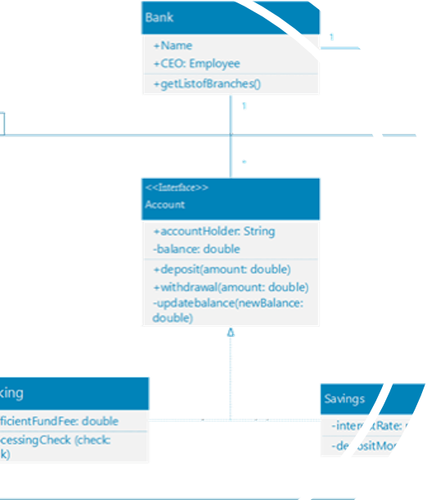
Mining object-oriented programs and encoding concepts. IFT6253-TERM PROJECT
Learning the composition of models.
Meriem Ben Chaaben
Meriem.ben.Chaaben@umontreal.ca

Slide 2





Outline
Context & Problematic
Suggested solution
Approach
Details & Implementation
Conclusion

Slide 3
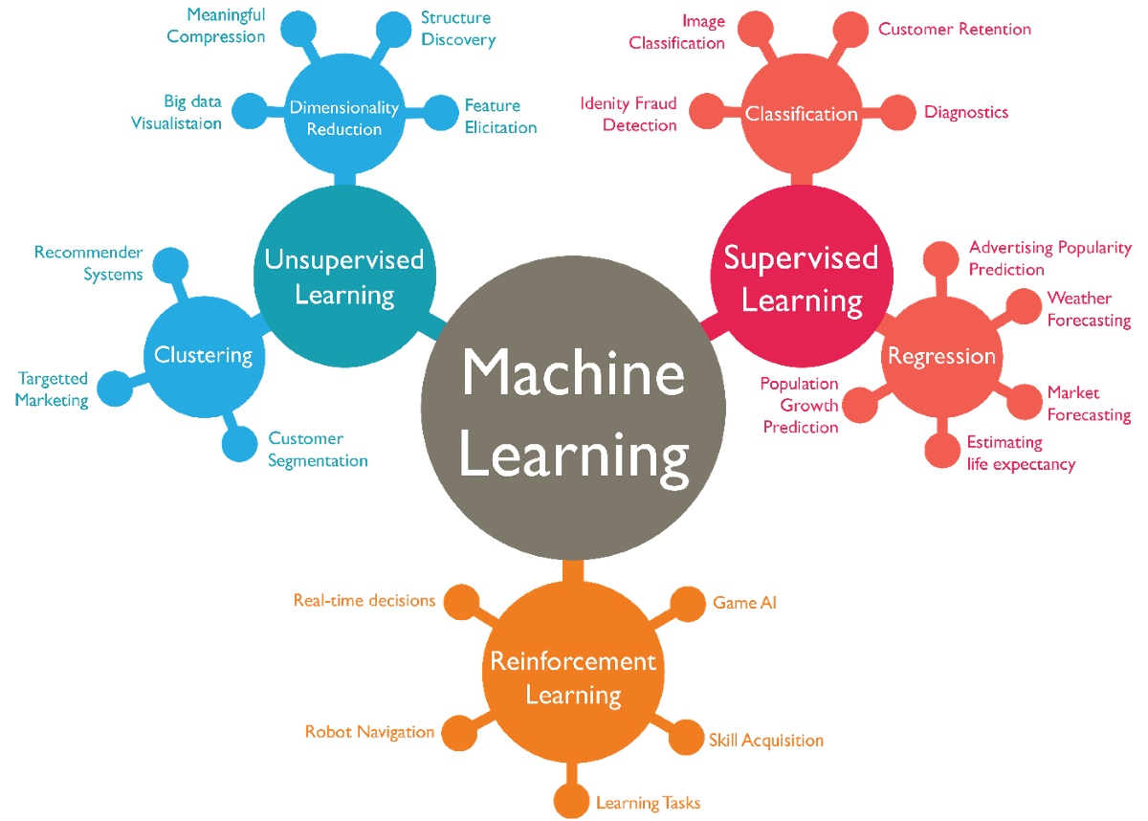
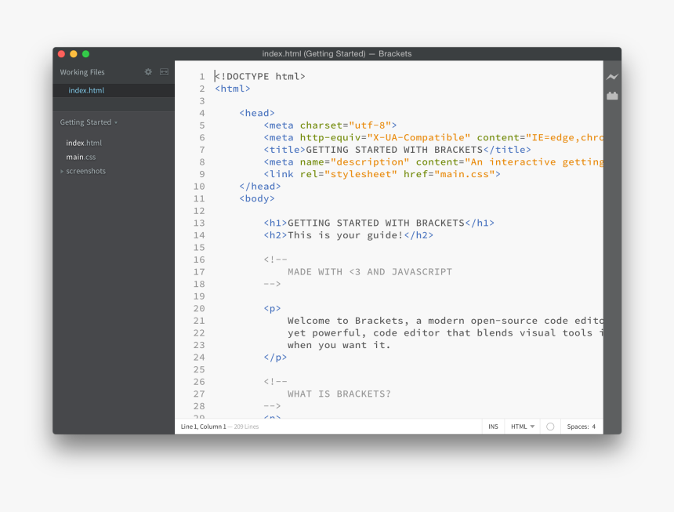
Context & Problematic
Encoded concepts
Goal: A method to mine object oriented projects and identify concepts, patterns & relation between elements.

Slide 4
Context & Problematic
Related work
Use of document embedding technique (Parsing, regular expression, nlp)
Behavior (execution traces) of programmes
Capture both lexical and structural information using textual tree structures(MDE principles).
Notes:
Let me start by highlighting some ideas were used in previous work,
The first one is to use document embedding technique. They do parsing and use regular expressions and other nlp techniques in order to retrieve what they are looking for. You may notice that this method lucks generecity and needs too much logic and effort to be implemented.

Slide 5
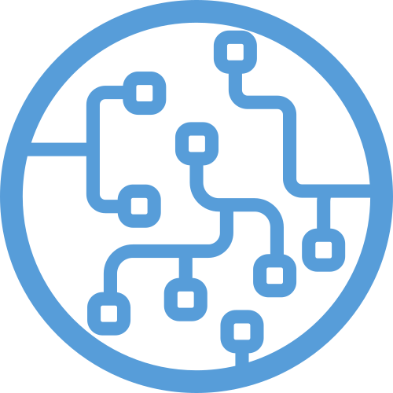


Suggested Solution
MDE principles
Discovered input
OOP
Machine learning algorithm
Notes:
In our project, we will also apply MDE principles since by definition they provide a better understanding of complex systems thanks to a high level of abstraction.
The idea is to use some of the principles that we already saw in this course such as transformations in order to
first identify useful elements and
second encode the obtained elements to the Appropriate way.

Slide 6
Challenges
Complexity of Data Extraction
Defining the exact elements that we need for each transformation step.
Automating the process.
The right tools to work with
Notes:
The challenges that we have been tackling are the following :

Slide 7

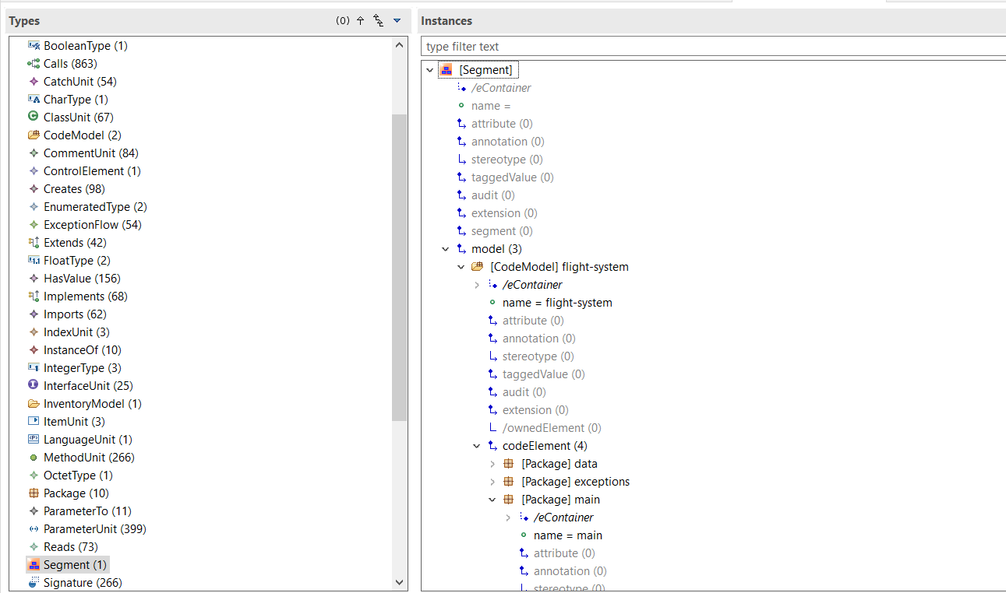
How should we proceed ?
Discovering the Object oriented Project
Run KDM discovery
XMI file
The KDM is an intermediate representation of software artifacts and its operational environment.
Notes:
Full coverage of the elements of the project
Modisco uses the KDM (an OMG meta-model for representing existing software, its elements, associations, and operational environments).
Fortunately, Currently, KDM supports a number of procedural and object-oriented programming languages. In my case I m focusing or at least I have been trying JAVA projects.

Slide 8
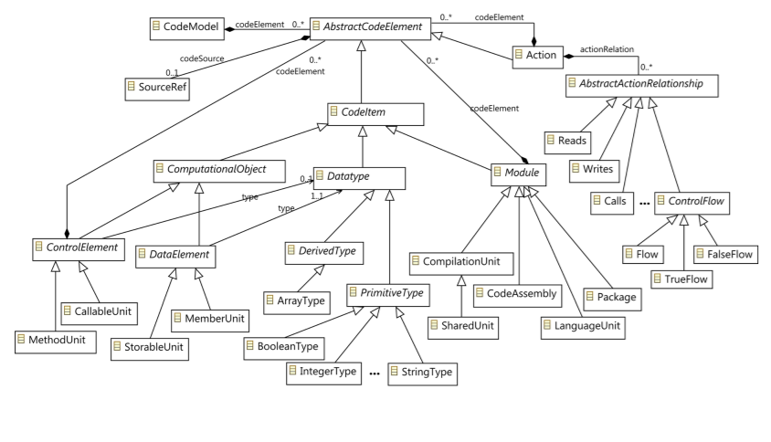
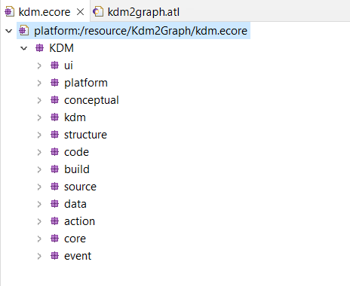
How should we proceed ?
KDM
Is it suitable to our Scenario ?
Notes:
Still at this step , we had to ask ourselves, is this level of complexity suitable for our purpose? No because no matter what transformation language we use we will need to implement a lot of logic in order to extract specific elements (remember our scenario is to prepare the data for a Graph based neural network)

Slide 9

How should we proceed ?
A model-To-Model Transformation
KDM metamodel
Graph
metamodel
Discovered OOP
Derived Model
Notes:
The idea is then to concieve a new metamodel that contains what we are exactly looking for.
To do so we thought about using ATL as a model 2 model transformation language.

Slide 10
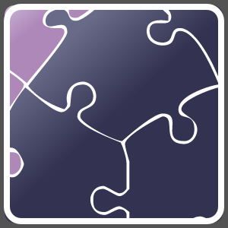
How should we proceed ?
A model-To-Text Transformation (code generation)
Graph
metamodel
CSV file
Derived Model
EGL
Notes:
Once the simplified model is obtained we need to generate csv files that will serve as input to a certain GNN model later. ( you will understand why csv files later)

Slide 11

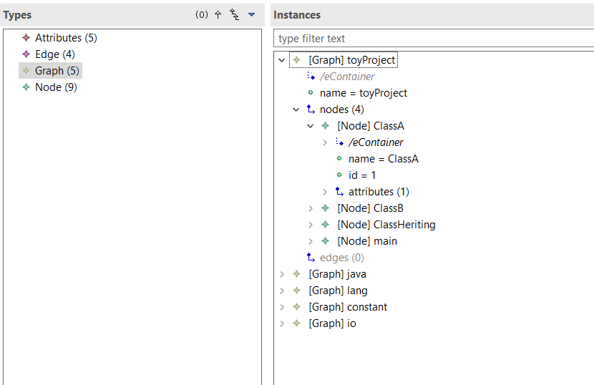
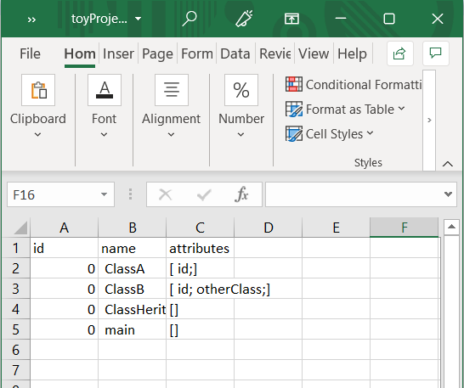
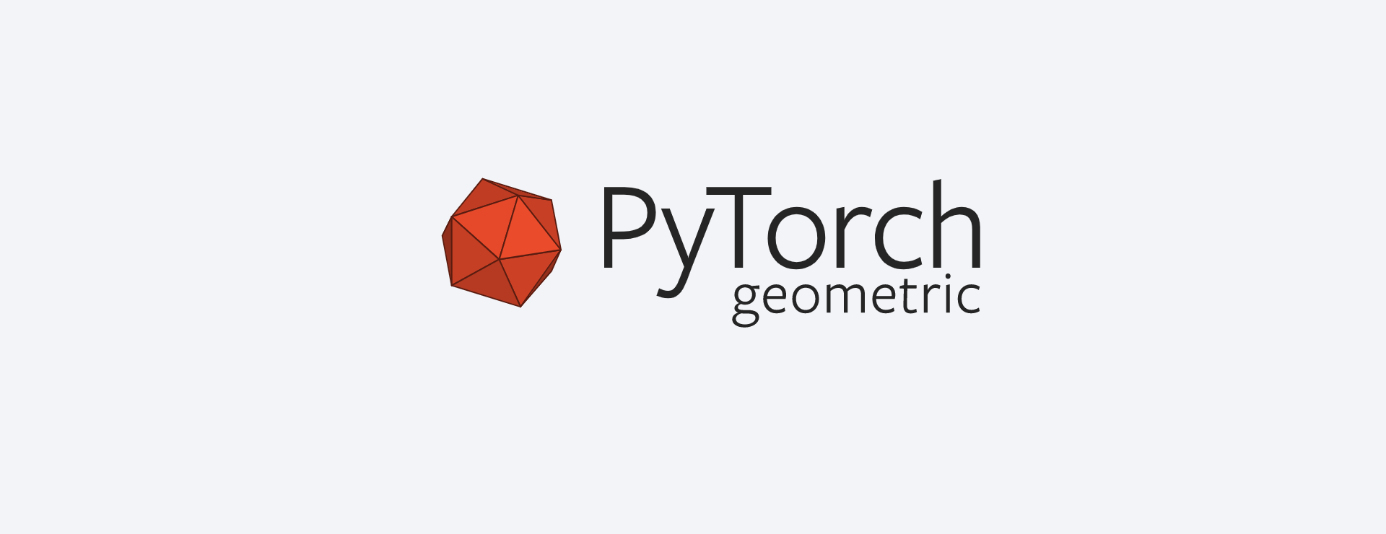
M2M transformation
Discoverers
KDM results
Refined Model
(graph model)
Model understanding
EGL
M2T transformation
Load data
Generated csv

Slide 12
Details & Implementation
Model Understanding
Discovered project
Conforms to
Not suitable for our Scenario.
Notes:
So we have to move from this huge metamodel to simpler one.

Slide 13
M2M transformation
Discoverers
KDM results
Refined Model
(graph model)
Model understanding
EGL
M2T transformation
Data loading
Generated csv
Notes:
But first, we need to understand the final output to be prepared in order to concieve our metamodels that will serve for the different transformation

Slide 14
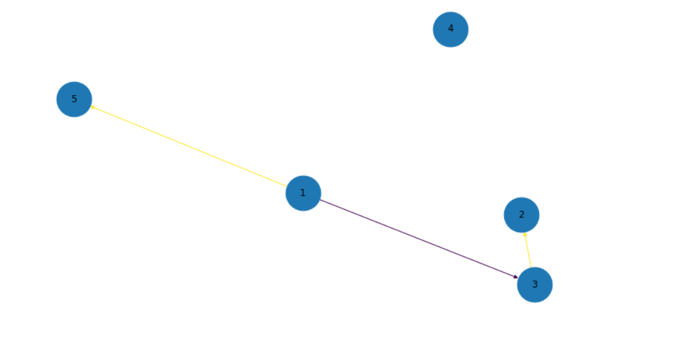
Details & Implementation
Loading Data ? what input do we need?
Node1 | Node 2 | Type
Nodes.csv
Id | Class Name | Attributes
InMemoryDataset
Edges.csv
Notes:
pytorch geometric tool ( ofc to implement and test the code I had to use fake data)
Torch geometric elements are very specific .
It uses .csv files as input and construct a homogenous graph from it !
You understand now why I am generating that format.
two files are required for each mined project, one for the nodes that represent the classes or concepts and one for the edges that should be representing the relationships (between different classes) .

Slide 15
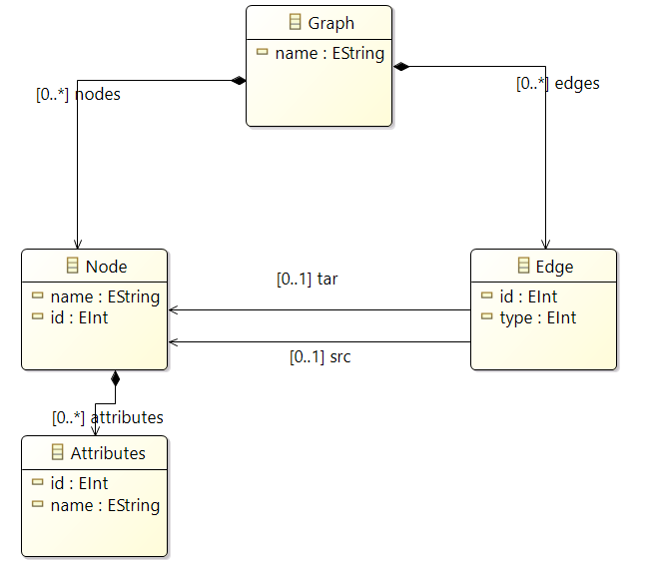
Details & Implementation
Graph metamodel
Node1 | Node 2 | Type
Nodes.csv
Id | Class Name | Attributes
Edges.csv
Notes:
In order to generate these files, we will peroform model to text tarnsformation using EGL tool.
This is the metamodel then that we prepared for our scenario.
So we have the Nodes that represents the classes and the edges that represent the relationship between the classes (it could be either inheritance or association)
You may notice that in futur work it is possible to add any attribute or concept without having to go through all the process.

Slide 16
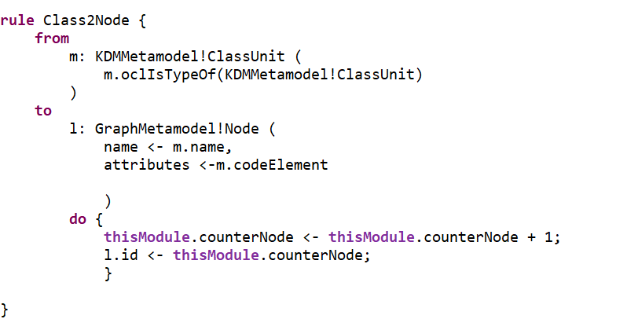
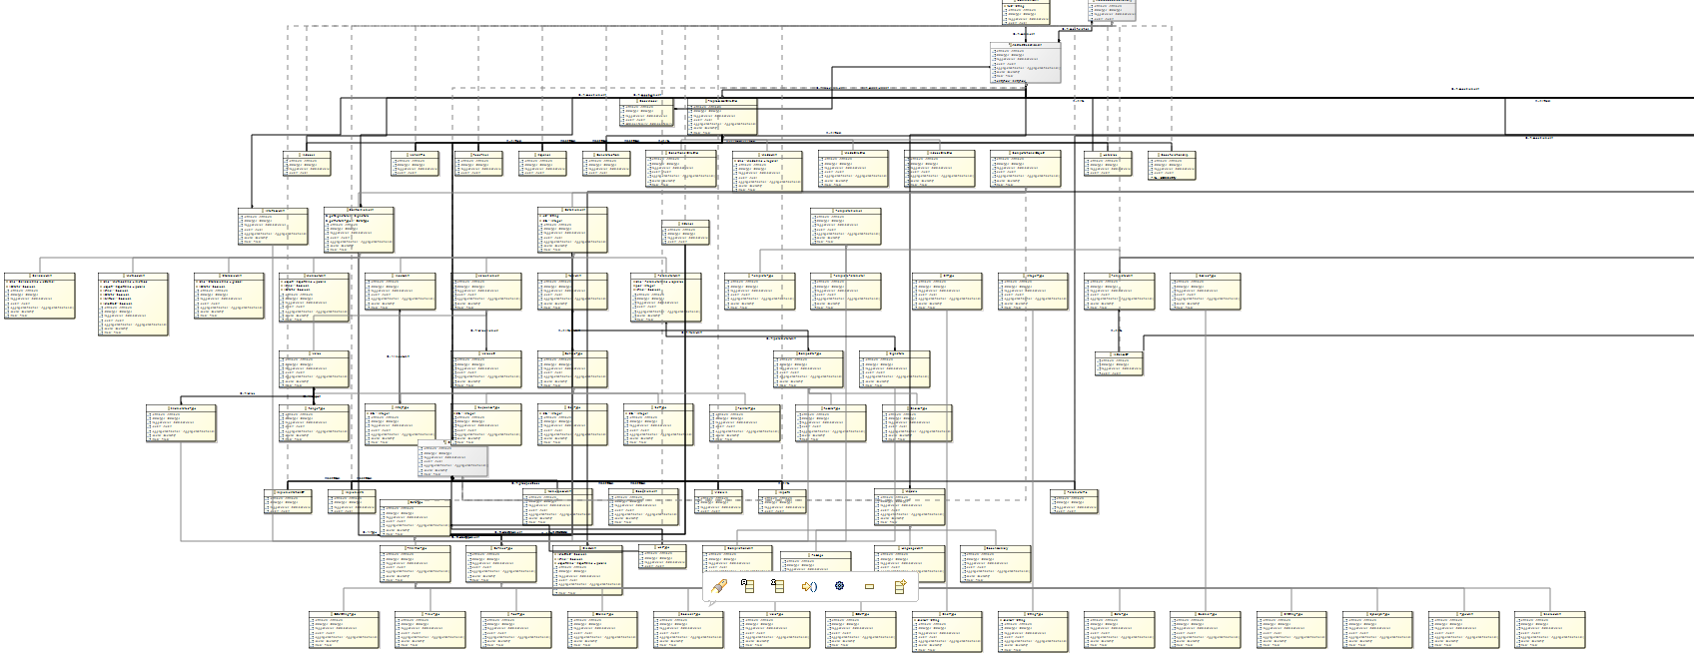
Details & Implementation
Code generation / template based transformation
Notes:
Now that it is clear why we have to carry out a model transformation, it is time to talk about how we have actually defined the model transformation.
As far as I am concerned, This is the hardest part,
The problem is actually with the Edge class because we don’t have an immediate match between the two models. Unlike for example the nodes.
******
This is the matching rule used. Fortunately we have ClassUnit that should corresponds to our nodes.
Since we handle the mapping between files using the ids , we should take care of implementing this, as you can see here the code for that.

Slide 17
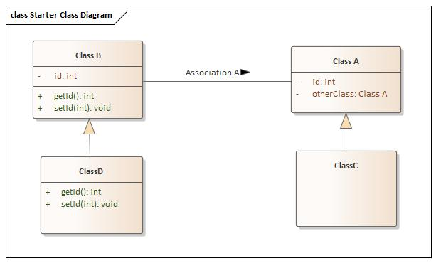
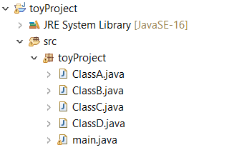
Example
Toy Project
Notes:
We move finally to execute the pipeline on a concrete example!
This is the structure of a Java project I created , toyProject , this is it’s concrete syntax.
We can see two inheritance and one association.

Slide 18

Example
Model discovery
Notes:
We first have the discovery step. Once configured everything should work correctly. I am also working on automating this.

Slide 19
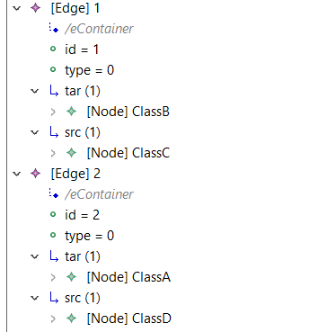
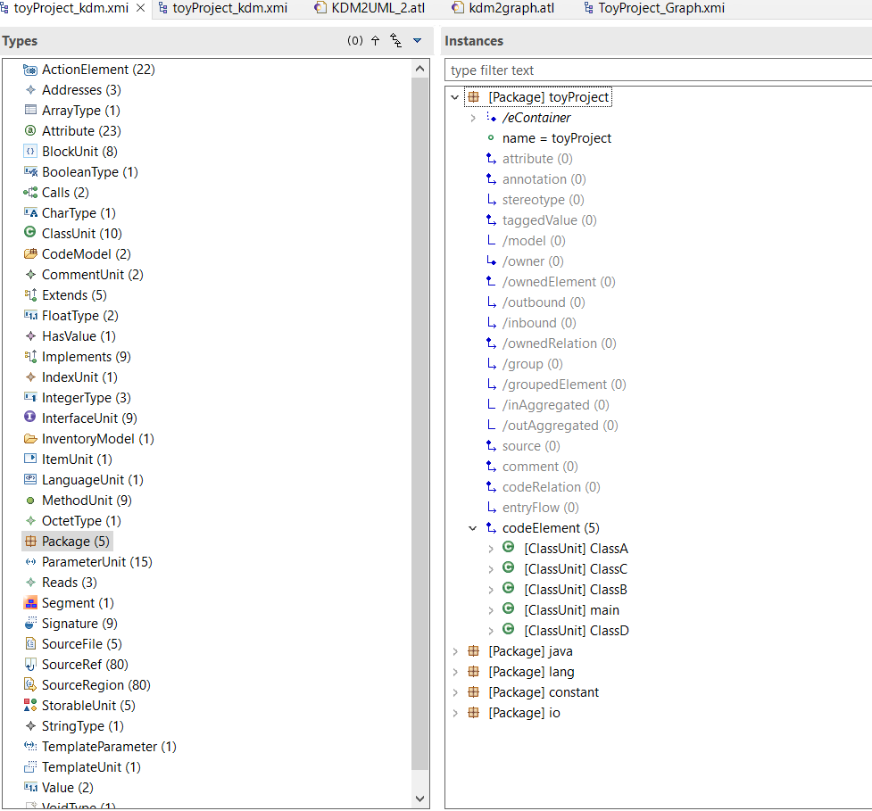
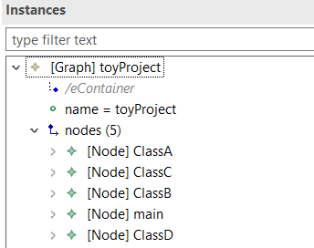

KDM2Graph
Notes:
Second the KDM2Graph step; Performing the ATL file, we obtain this. We see the edges , the graoh and the nodes.
***** click !
It is challenging because it is not easy to find for each concept it’s corresponding one !
I am now for example blocked , I can’t figure out how am I going to extract a non inheritance association because in KDM we can’t find it explicitely. I believe a lot of complicated and advanced logic should be implemented.

Slide 20
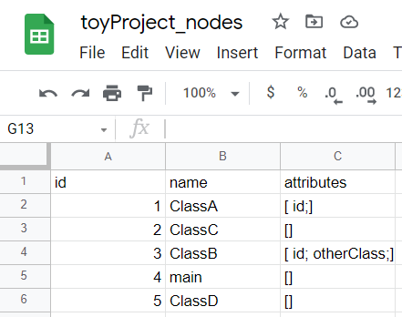
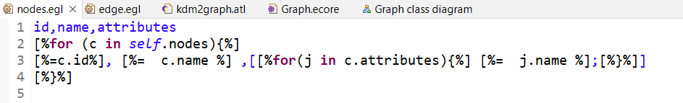
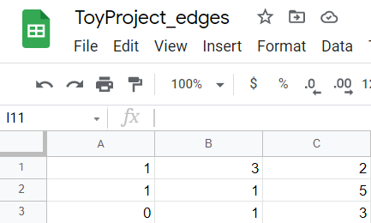
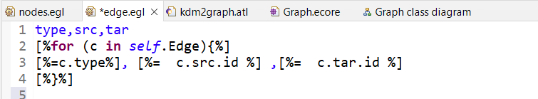
Graph2Csv
Notes:
The next step is generatinng the csv files.
As you know it is template based,

Slide 21
Loading Data
Notes:
At the end, we have here the source code implemented that should load the prepared data and create the graphs. To visualize the results I tried to plot the graphs obtained.
We have the edges and the node. (we have different colors which means different types od edges)

Slide 22
Conclusion
We presented a novel approach to learn model domain concepts and relationships between these elements.
Challenges tackled:
Genericity:
It’s scenario independent
(for now only tested on Java)
Automation:
Working on That….(ATL ok, Modisco (depreciated ….),chaining)
Scalability:
Bigger projects (tested on two public github projects.)
Extendibility:
More features could be added easily. (metamodels++)
Notes:
It’s not scenario dependent
We are dealing with metamodels !

Slide 23
Thank you !

